Slide 1
Github REPO. aggregator api
A Pitch By Tribe F

Slide 2
Group Members
Rahil Gandhi
Arjun Rakwal
Kaushal Kumar
Anala Abhi Ram
Yadvika jayam.N
Sanket Naik
Somil patil
Priyanshi Mishra
Nand Kishor Singh
Ranjul Arumadi
Vishal Dudgikar
V. Vivek

Slide 3
01
Introduction
02
Overview
Table of contents
03
Requirements
04
Tech Stacks

Slide 4
Introduction
What is an API ?
Scope
Role of a Robust Language
APIs are used to send / receive requests from a client or server.
There are wide range of uses for an api, get data from an external source, trim according and use it.
Python being the most used language for data handling

Slide 5

01
How an API works and how it can be used

Slide 6
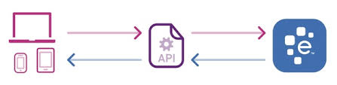
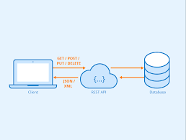
introduction
What is an API ?
Applications of an API
Scope of the projects

Slide 7




Project Overview
Github API
Deployed Software
Tkinter UI
2
3
1
As soon as a query request is made with the github id, the API sends the data
The software send server requests and receive data from the server and process it
Upon receiving the normalized data, we display the data using Tkinter UI

Slide 8



Input Requirements
Git Token
Github Id
Server
Token / public key to access Git API, generated by github
A search query to fetch details for ( Repositories, commits, contributors )
Send request using the server to the github api

Slide 9
Output Data
Repository Name
Contributors
Date of Commits
(Start - End )
If the server request is valid or not
(Success / Failed Run)

Slide 10
Approach 1
Tech stack (1) : Well Designed UI
Combining the frontend , backend, framework technologies we develop a robust UI to render data dynamically

Slide 11




Tech Stack ( 1 ): Using React & Javascript
Processing data using javascript
Github Data Source
Dynamic Rendering using Javascript & React
Static Page
(HTML & CSS)

Slide 12
Approach 2
Tech stack (2) : Basic UI
Combining python inbuilt modules together with dependencies

Slide 13
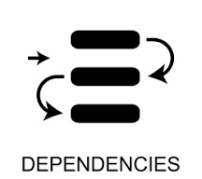
Tech Stack ( 2 ) : Python & Tkinter
Processing & Normalizing Data using Python
Github Data Source
External modules and dependencies
Displaying Received data using Tkinter

Slide 14
Thank You
We Would love to answer any question :
Not sure about the tech stack ?
Want some changes ?

